Slide 1
NE 591: Advanced Reactor Materials
Fall 2021
Dr. Benjamin Beeler

Slide 2
Last Time
Key thermophysical properties includes thermal conductivity, CTE, creep, etc., and vary strongly based upon composition
Two primary phases: UC and U2C3
Three stages in burnup that affect centerline temperature
Fuel restructures into typically three zones with variable porosity
Carburization of cladding is the key FCCI phenomenon
Control of C/M ratio via initial hyperstoichiometry prevents low melting metal phases forming
Carbothermic reduction is primary fabrication route

Slide 3
Nitride Fuels
Nitride fuel has been proposed as an advanced fuel for fast reactors and developed since the 1960s and tested in the BR-10, FFTF, and EBR-II reactors
Nitride fuel is a solid solution of uranium mononitride (UN) and plutonium mononitride (PuN), in which the Pu/(U+Pu) molar ratio ranges from 0.15 to 0.25
Nitride has also been proposed as a fuel for space reactors
UN, PuN, and minor actinide mononitride (U,Pu,MA)N, has been proposed as one of the candidate fuels for Gen IV-type fast reactors
U-free nitride fuel, such as (Pu,MA)N diluted by ZrN, has been studied for MA transmutation accelerator driven systems

Slide 4
Nitride Fuels
Higher fissile density: 40% more uranium in UN than in UO2, leading to higher conversion ratios, and potentially higher burn-ups
Higher thermal conductivity: reduction of the fuel centerline temperature, increase in the margin for fuel melting, delay the migration of fission products and actinides
Reprocessing: readily dissolve in nitric acid (HNO3), making this fuel compatible with the PUREX process
Stability: chemically compatible with most potential cladding materials, good irradiation stability
Potential for longer fuel cycle: neutronic behavior of UN can extend cycles from 18 to 25 months, reducing costs and down time

Slide 5
Drawbacks of Nitrides
Fabrication: the production of minor actinide (or even plutonium) containing nitride fuel is not straight forward and require some difficult production steps
Oxidation resistance: the nitride pellets readily oxidizes in superheated steam
Nitride powder is pyrophoric, requiring strict atmospheric controls during fabrication and handling
Fuel enrichment: the nitrogen component has to be highly enriched in ¹⁵N to increase the neutron economy and avoid the (n, p) formation of ¹⁴C from ¹⁴N, which significantly increases costs
Fuel fabrication and N enrichment have led to slower development of MN fuels than MC fuels

Slide 6
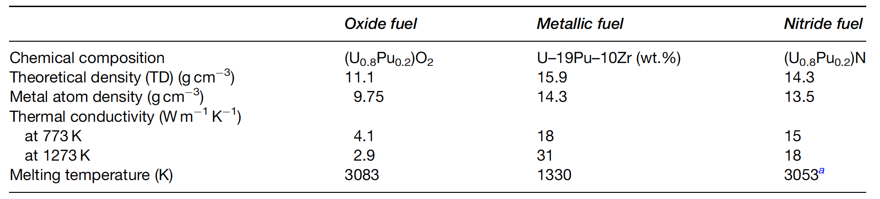
Nitride Properties

Slide 7
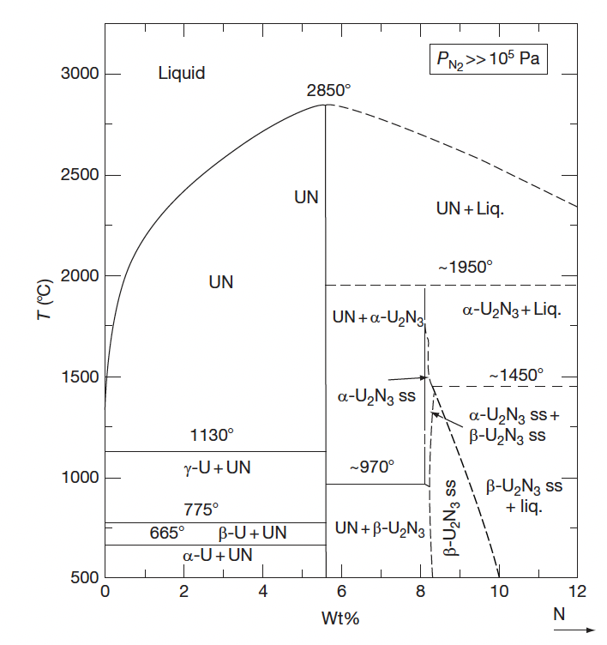
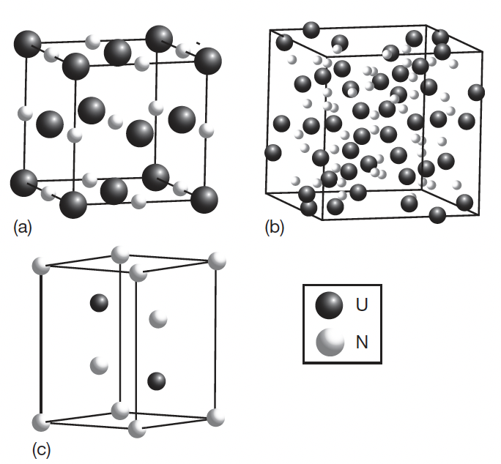
UN Phase Diagram
UN
Alpha-U2N3
Beta-U2N3

Slide 8
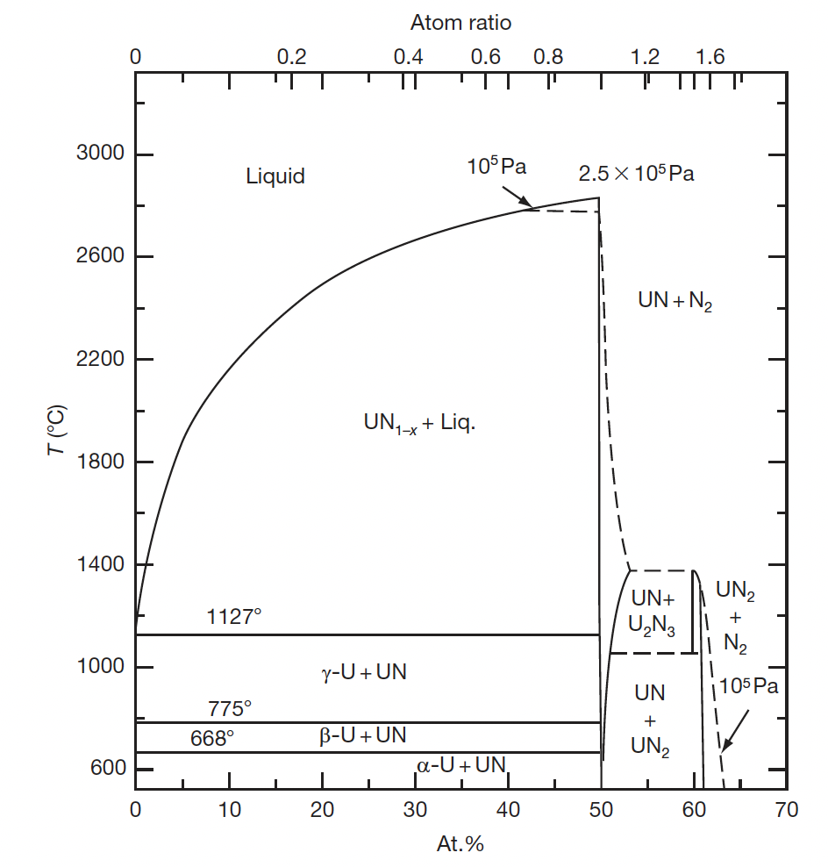
UN Phase Diagram
Where nitrogen pressure is greater than 10⁵ Pa, UN melts at 3123K and that UN and U2N3 have a wide range of nonstoichiometry
At lower nitrogen pressure (<2E5 Pa) UN decomposes such that UN and U2N3 have little nonstoichiometry
At low P_{N}, the beta-U2N3 phase changes to UN2
U2N3 decomposes to UN, and UN decomposes to U and nitrogen at nitrogen pressure below 2.5 atm

Slide 9
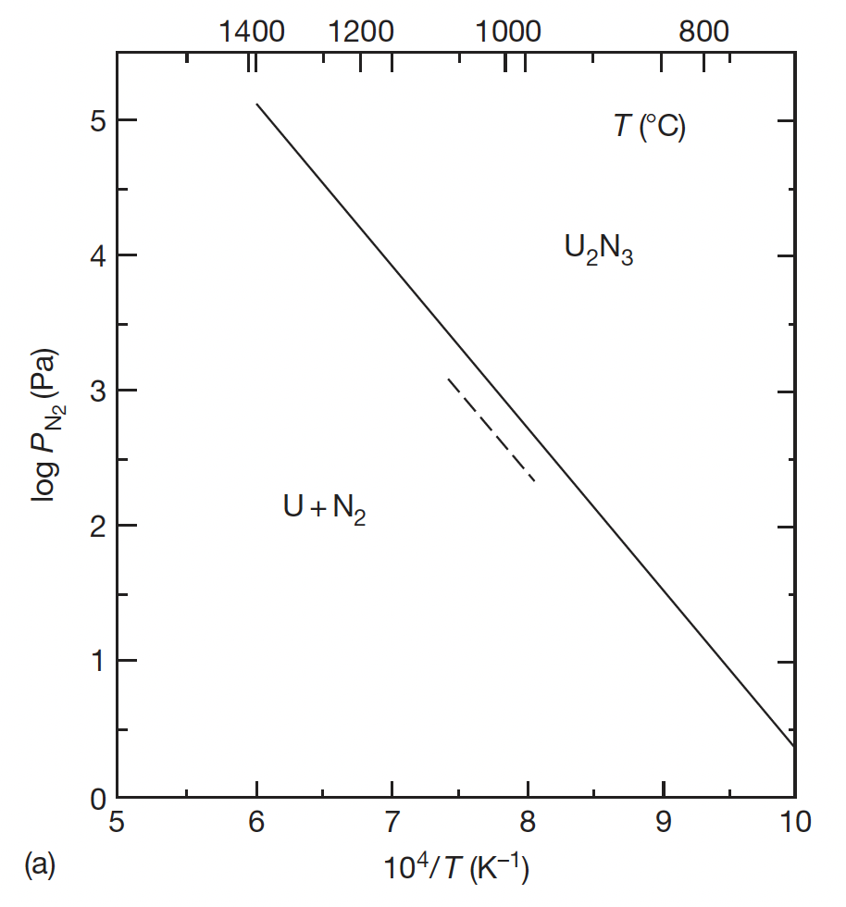
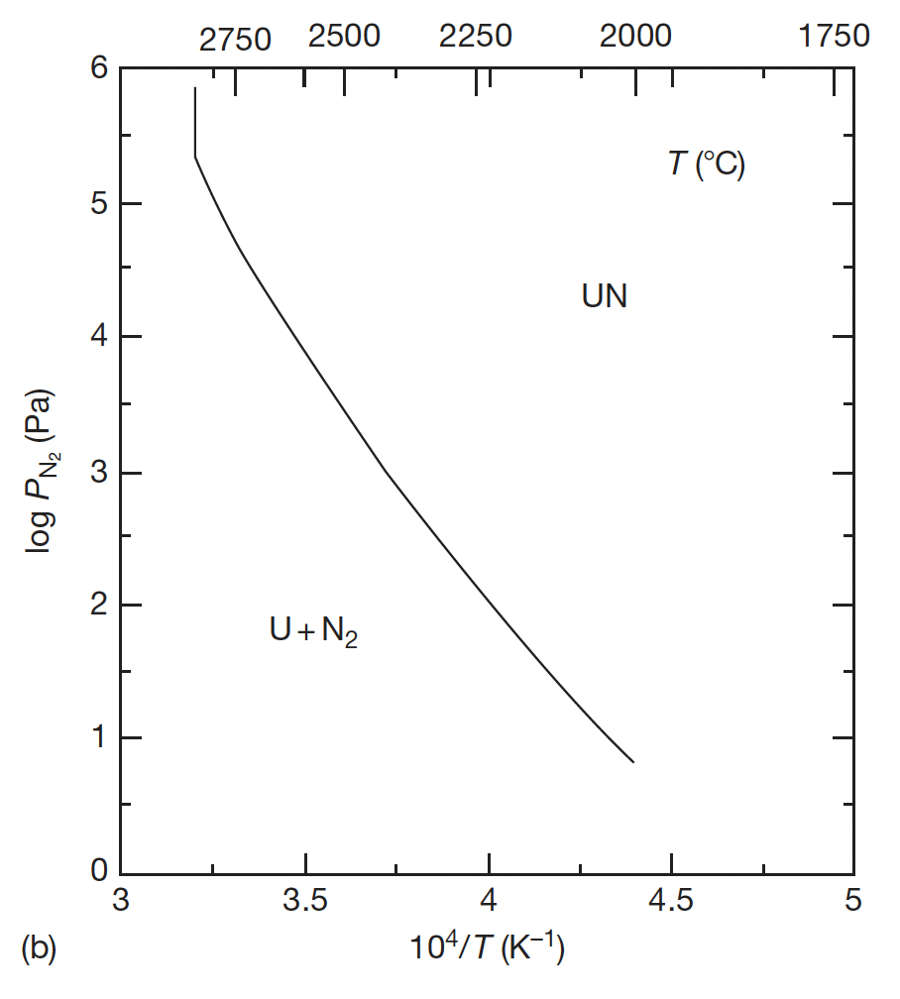
UN Decomposition
The decomposition of U2N3 is the last stage in the formation of UN through carbothermic reduction, thus the equilibrium nitrogen pressure of UN and U2N3 is very important from the viewpoint of their use as nuclear fuels
UN decomposes at 3073K and U2N3 decomposes 1620K at nitrogen pressure of 1 atm

Slide 10
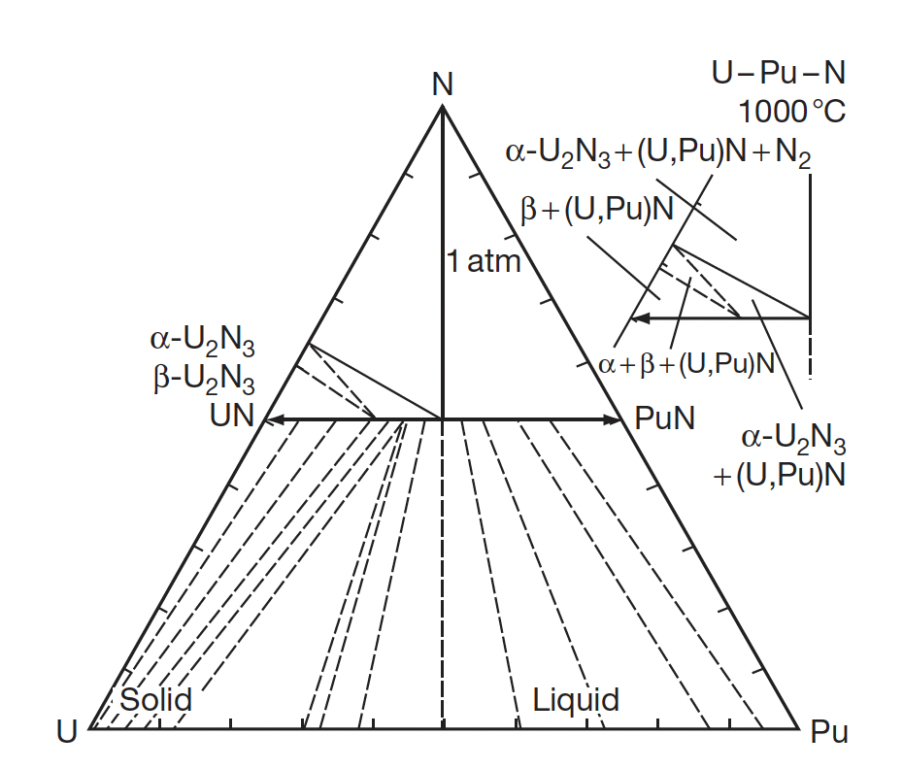
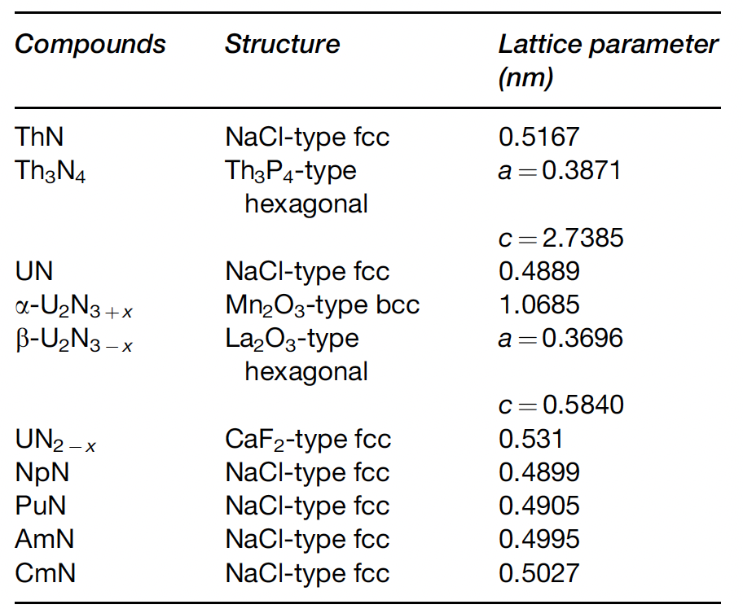
MN Crystal Structure

Slide 11
Ternary U/Pu-N
The ternary system is characterized by a complete solubility of UN and PuN
The (U,Pu)N phase has a narrow composition range of the N/(U+Pu) molar ratio
Although Pu2N3 does not exist in the Pu–N system, a sesquinitride phase was identified in the U–Pu–N system at a Pu/(U+Pu) molar ratio of 0.15
In a mononitride lattice with NaCl-type structure, small nitrogen atoms are incorporated into a dense face-centered cubic packing of metal atoms

Slide 12
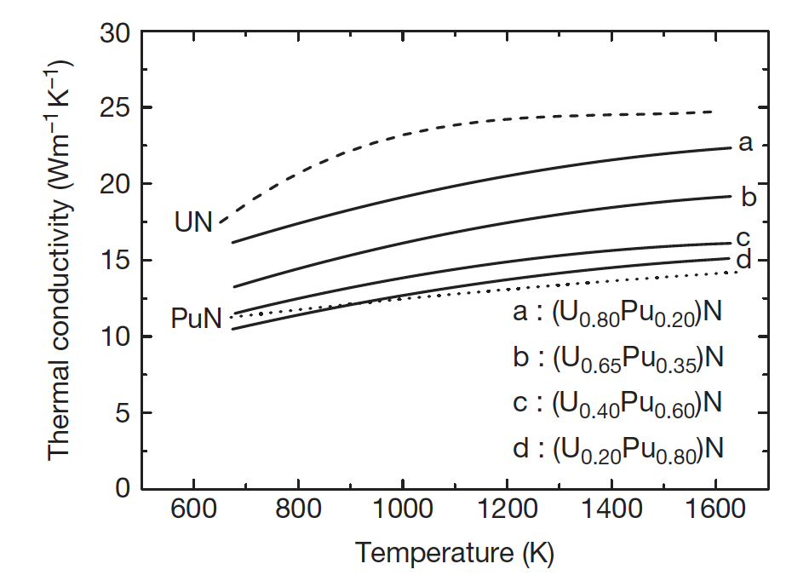
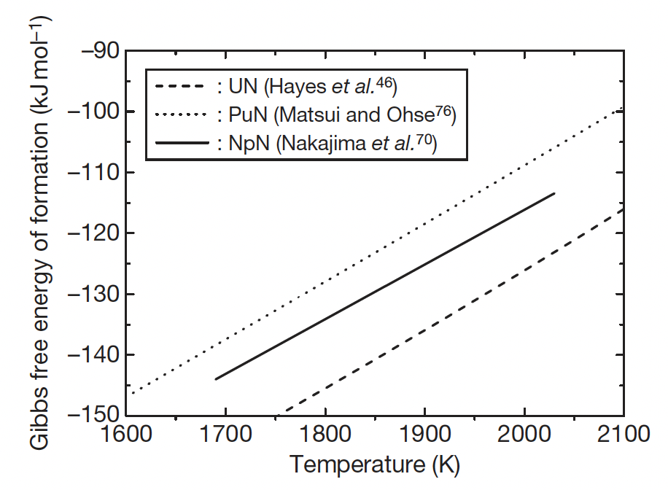
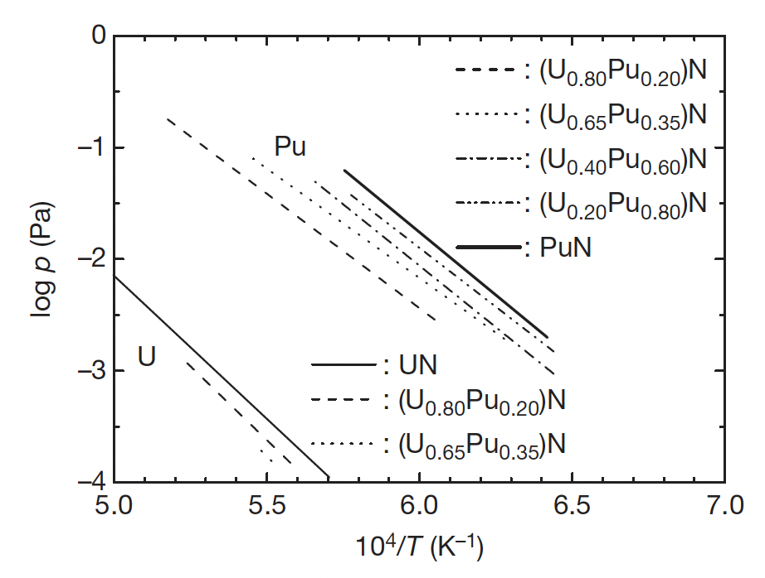
Effect of Pu on U/Pu N Properties
The addition of Pu can dramatically affect thermophysical properties
Pu is more volatile than U, and has a higher vapor pressure
Pu degrades the thermal conductivity by as much as 2X
PuN is less stable than UN, and could be susceptible to radiolysis

Slide 13
Nitride Fabrication
Similar to carbide fuels, preparation of nitrides from either metallic sources or from the hydriding-dehydriding process were explored in the 1960s and remain an option for laboratory implementation
These reactions are exothermic and should be carried out slowly by temperature cycling for better control of the products
It is difficult to apply the metal or hydride route to a technological fuel production line
These processes include the nitridation of U or Pu metal in N2 or NH3 at 1073–1173 K, arc-melting of U or Pu metal under N2 pressure, nitridation of fine-grained U or Pu powder formed by the decomposition of hydrides with N2 or NH3 and direct reaction of UH3 or PuH_{2.7} with N2 or NH3

Slide 14
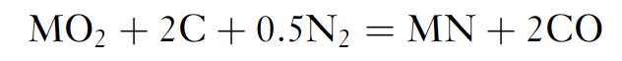
Carbothermic Reduction
Carbothermic reduction is the most widely used process for preparing nitride fuel
The starting material is a dioxide and carbon, and the general reaction is
The mixture of dioxide and carbon is heated in N2 gas stream, usually at 1773–1973 K
An excess amount of carbon is usually added to the mixture to reduce the oxygen content
The residual carbon is removed from the products by heating in a N2-H2 stream
The initial C/MO2 mixing ratio was historically chosen at 2.2–2.5 for the preparation of UN and (U,Pu)N
For the preparation of UN and (U,Pu)N, the atmosphere is changed to Ar or He from N2 or N2–H2 to prevent the formation of higher nitrides

Slide 15
Carbothermic Reduction
Typical impurities in nitride fuel prepared by carbothermic reduction are oxygen and carbon
The level of impurities can be kept lower than 1000–2000 ppm for both oxygen and carbon by adjusting the initial C/MO2 mixing ratio
Carbonitrides (U/Pu-C-N) have complete solubility in the MN systems, while oxides have solubility around 10%
MA-N can be manufactured in the same way, but has different C, N, and O potentials, requiring slightly different mixtures of streams
Am also has a high vapor pressure and it is a challenge to keep it from vaporizing during fabrication
This requires operating at lower temperatures for the N2 stream
Unlike carbides, Pu volatilization is not an issue

Slide 16
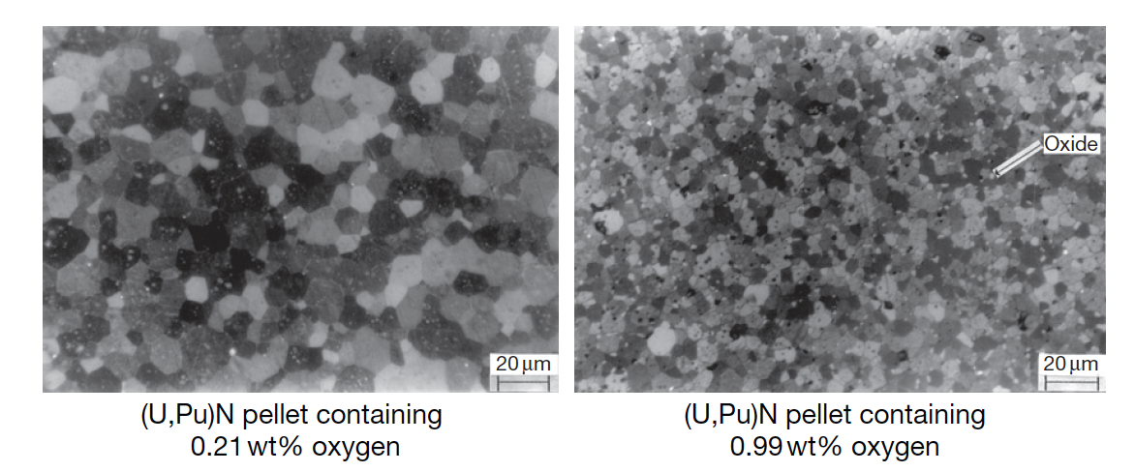
Nitride Pellets
Nitride fuel pellets are usually prepared by a classical powder metallurgical manner; the product of carbothermic reduction is ground to powder by use of a ball mill, pressed into green pellets and sintered in a furnace at 1923–2023 K
Actinide nitride powder has a low sinter-ability in comparison with that of oxide or carbide powder, which is derived from a low diffusion rate of metal atoms in mononitrides
A high sintering temperature (i.e., T>1973 K) is necessary for preparing dense UN or (U,Pu)N pellets higher than 90% TD
Oxygen impurities tend to promote the sintering of UN, but greater than 1 wt% decreases the density and results in an overly fine grain structure

Slide 17
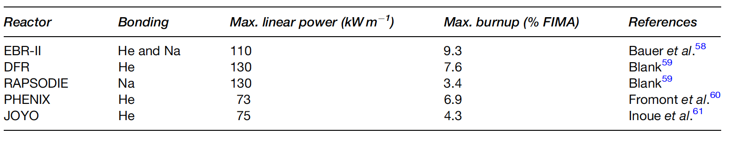
UN Irradiation
The irradiation experience of nitride fuel is rather limited in comparison with the other fuels for fast reactors, such as oxide, metallic, and carbide fuels
The number of (U,Pu)N fuel pins irradiated in fast reactors so far is smaller than 200
UN pins have reached 10% FIMA in fast reactors, and greater than 15% FIMA in thermal reactors

Slide 18
UN Pins
Similar to carbides, pin designs are either He-bonded or Na-bonded
He-bonded fuel pin is characterized by low-density pellets (80–85% of theoretical density (TD)) and a small gap
Na-bonded fuel pin is characterized by high-density pellets (>90% TD) and a large gap
Na-bonded concept has the advantage of keeping the fuel temperature relatively low due to good thermal conductivity of liquid Na
Difficulties with Na are the reactivity in air, and additional hurdles in fabrication and reprocessing

Slide 19
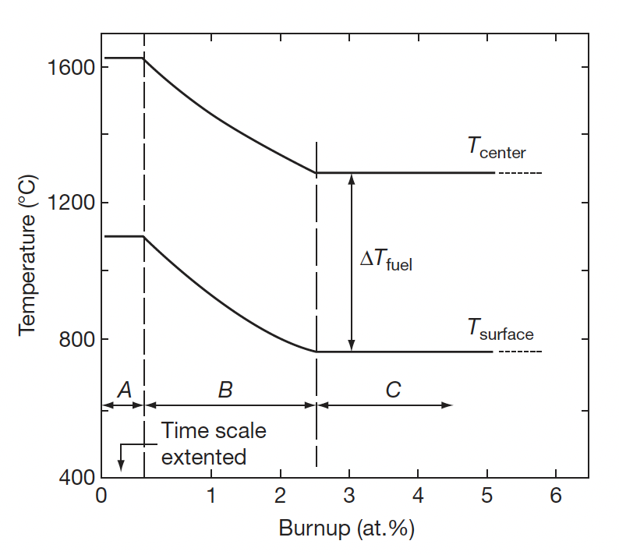
UN Pins
The He-bonding concept is considered as the reference for (U,Pu)N fuel
The temperature of fuel pellets becomes high in comparison with the fuel with Na bonding, especially at an early stage of irradiation
The small gap is closed by free swelling of fuel pellets at a burnup of 2–3% FIMA

Slide 20
Temperature with Burnup
Similar to carbides, have three stages in temperature
Stage A is the first rise of power and lasts for one to several days
Stage B has the resintering of pellets center and closure of He gap
Stage C is the quasi steady state irradiation period in which FCMI begins
The TD of the fuel is reduced to ~80% to avoid excessive strain on the cladding

Slide 21
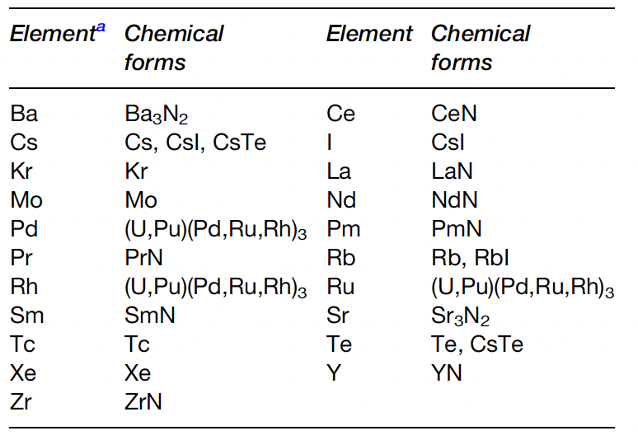
Fission Products
Fission products can form various nitride phases in the fuel matrix
Noble gases will of course not react with N, and volatile species (Cs, I, Te) will form volatile compounds
Pd, Rh, and Ru form metallic precipitates
Rare earths are dissolved in the U/Pu-N matrix
The N/U ratio was evaluated and reported to increase by 2% at a burnup of 10%

Slide 22
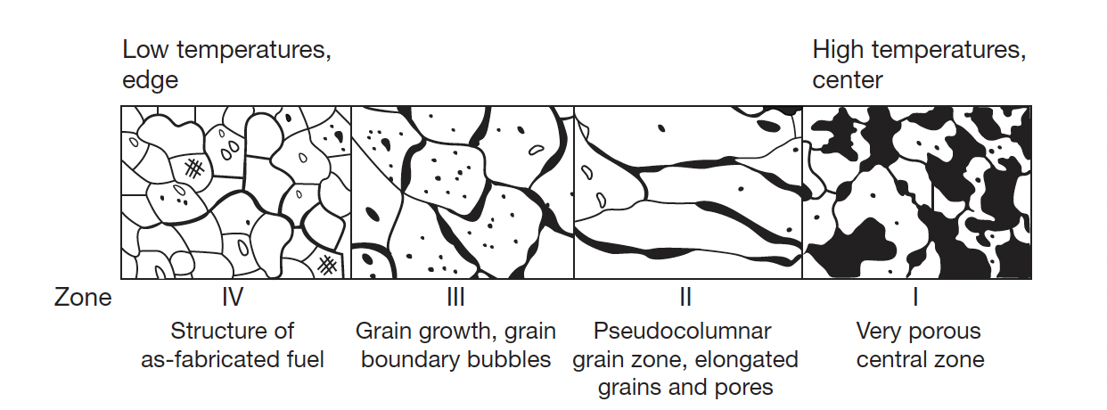
Nitride Restructuring
Because of relatively low fuel temperature and temperature gradient, the restructuring of (U,Pu)N fuel is mild in comparison with MOX fuel for fast reactors
For He bonded pins at high power, restructuring does occur with three distinct zones
Zone 1 is found in the central of the fuel pellet was characterized by very porous structure; a small central hole was sometimes observed

Slide 23
Nitride Restructuring
Zone 2 is found in MOX fuels and sometimes in carbide fuels, but not in UN fuels
Zone 3 displays grain growth, grain boundary bubbles, and healing of cracks
Zone 4 has the as-fabricated structure
Fission gas release is prevalent in zone 1 and zone 3, with large amount of UN swelling

Slide 24
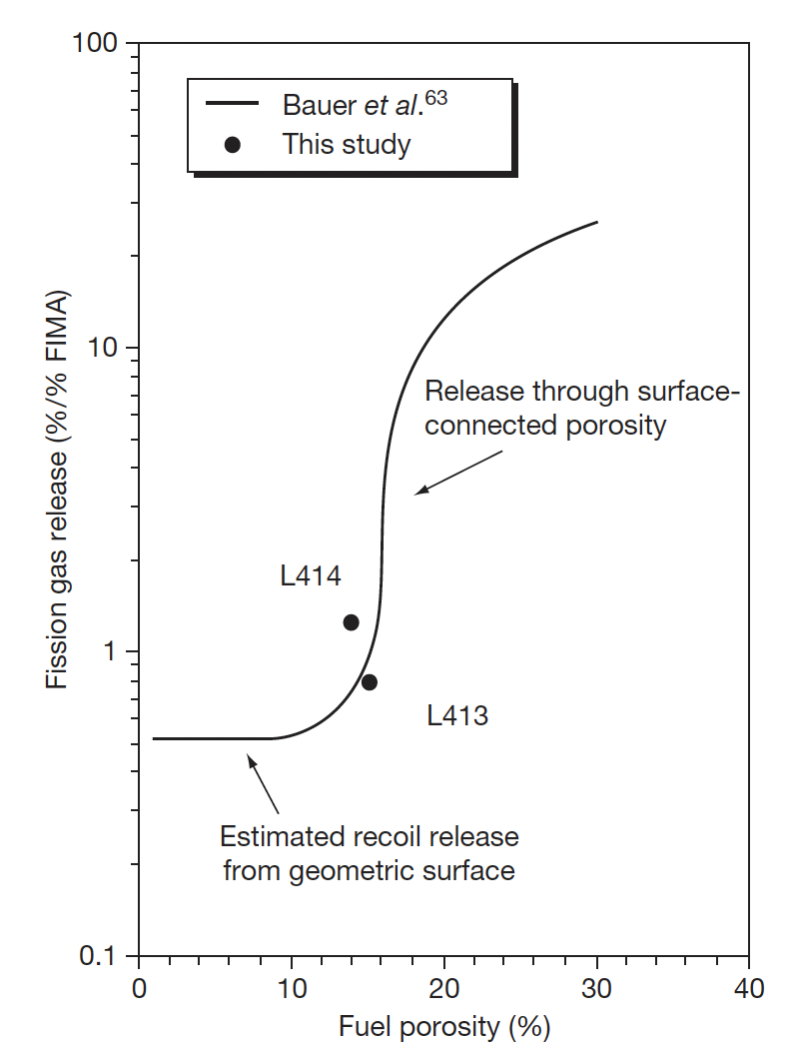

Fission Gas Release
There have been no systematic results dealing with fission gas release of nitride fuel, due to limited irradiations
It is generally known that FP gas release of nitride fuel is much lower than that of MOX fuel
Gas release will be influenced by burnup, pellet density, grain size, the characteristics of porosities, and temperature
Fuel at 4.3% FIMA

Slide 25
Swelling and FCMI
Since FG release is low, its possible that swelling is large
Volumetric swelling is caused by the accumulation of solid FP and crack formation in the pellets
The volumetric swelling rate of (U,Pu)N fuel irradiated to 9.3% FIMA was evaluated at 1.83% per FIMA% without the constraint of the cladding tube
This is considerably higher than UO2 fuels, and lower than metallic fuels
The creep rate of (U,Pu)N fuel is low in comparison with MOX or metallic fuel at operating temperatures due to a slow diffusion rate of metal atoms in nitride fuel
Thus, focus has been placed upon the degree of FCMI in UN fuels
FCMI in a general sense can be mitigated by the reduced TD and operating at a reasonable linear power (<100kW/m)

Slide 26
Reprocessing
Both hydrochemical and pyrochemical processes were proposed for the reprocessing techniques
The disposal of long-lived ¹⁴C and the recovery of expensive ¹⁵N are key topics in reprocessing
Hydrochemical processes include the direct dissolution of spent nitride fuel in HNO3 and the voloxidation of spent nitride fuel followed by the dissolution in HNO3
The product of hydrochemical reprocessing is the nitric solution of U+Pu to be converted to oxide, and then to nitride by carbothermic reduction
Pyrochemical processing is very similar to that for metallic fuel

Slide 27
Summary
Nitrides have a higher U density and higher thermal conductivity than oxides, with a higher melting point than carbides
Difficult fabrication, requiring atmospheric controls and enrichment of N, especially in thermal or transmutation applications
Carbothermic reduction is the primary fabrication route
Very few irradiations have been performed, none to especially high burnups
Three stages in temperature, with gap closure leading to steady state behavior
Nitride fuel undergoes restructuring, with central porous region, large grained region, and as-fabricated microstructure
FCMI is a key life limiting phenomenon due to little creep in UN fuels

Slide 28
Exam 3
This concludes our module 3
Exam will take place next Tuesday (11/2)
Will cover molten salts, carbides and nitrides
DFT lecture and QE not covered, as that is project related

